Slide 1
New Antennas for modeling the nonlinear optics of plasmas & Non-uniform Particle Weighting
H. Wen, F. S. Tsung, B. Winjum, A. Tableman, K. Miller, W. B. Mori
University of California, Los Angeles

Slide 2
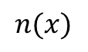
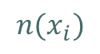
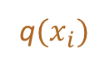
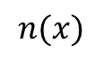
There are now two ways of Initializing particle positions and charges
Constant spacing
Particles are uniformly distributed in the simulation box, density profile is achieved by varying the charge of each particle
Constant charge
Same charge for every particle, density profile is achieved by varying the spacing between particles
$$n(x_{i})$$
$$n(x)$$
$$n(x)$$
q$(x_{i})$
q
grid
grid

Slide 3
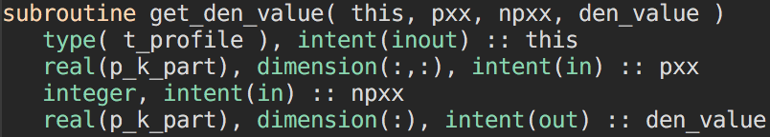
Same parameters and key functions exposed to the old initialization routine are used
Initialization routine (in os-spec-util.f03):
inject_area_grid( t_species this, ig_xbnd_inj), where ig_xbnd_inj marks the boundary cells to “inject” particles
Density profile is obtained by calling subroutine get_den_value
The global information can be access through t_species: density profile object, global coordinate, boundaries of local nodes in global coordinate, number of particles in each direction, grid size etc.

Slide 4
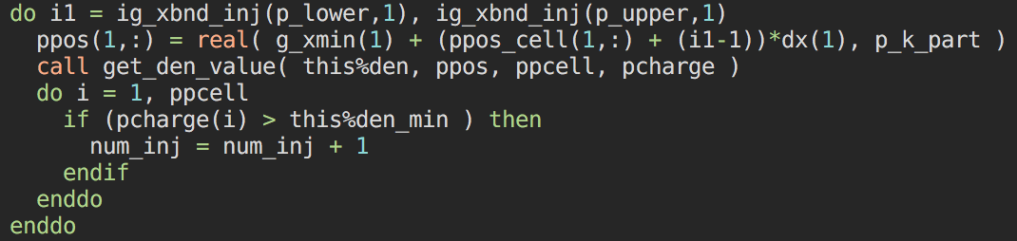
Main steps in the old initialization
Loop through all cells and count particle to inject
Increase buffer size if necessary
Loop through all cells again and inject particles, normalizing charge

Slide 5
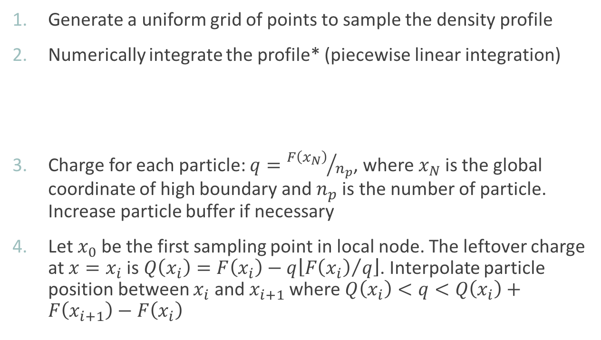
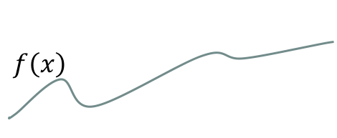
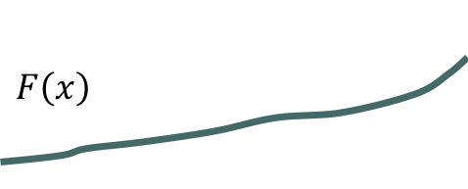
Main steps in the new initialization (1D case)
Generate a uniform grid of points to sample the density profile
Numerically integrate the profile* (piecewise linear integration)
Charge for each particle: $q={F\left(x_{N}\right)}/{n_{p}}$, where $x_{N}$ is the global coordinate of high boundary and $n_{p}$ is the number of particle. Increase particle buffer if necessary
Let $x_{0}$ be the first sampling point in local node. The leftover charge at $x=x_{i}$ is $Q\left(x_{i}\right)=F\left(x_{i}\right)−q\left\lfloor {F\left(x_{i}\right)}/q\right\rfloor$. Interpolate particle position between $x_{i}$ and $x_{i+1}$ where $Q\left(x_{i}\right)<q<Q\left(x_{i}\right)+F\left(x_{i+1}\right)−F\left(x_{i}\right)$
$$f\left(x\right)$$
$$F\left(x\right)$$
*Respect t_species::den_min when integrating

Slide 6
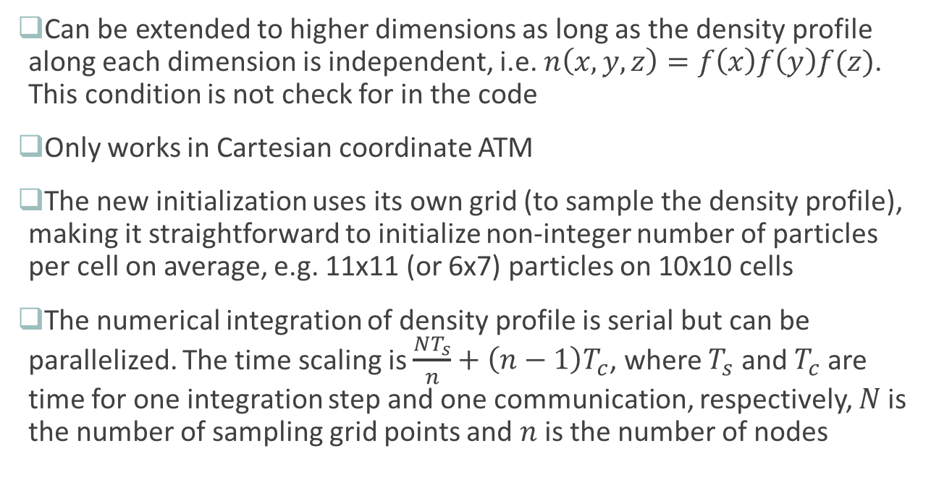
Limitations and possible improvements of the new initialization
Can be extended to higher dimensions as long as the density profile along each dimension is independent, i.e. $n\left(x,y,z\right)=f\left(x\right)f\left(y\right)f(z)$. This condition is not check for in the code
Only works in Cartesian coordinate ATM
The new initialization uses its own grid (to sample the density profile), making it straightforward to initialize non-integer number of particles per cell on average, e.g. 11x11 (or 6x7) particles on 10x10 cells
The numerical integration of density profile is serial but can be parallelized. The time scaling is $\frac{NT_{s}}{n}+\left(n−1\right)T_{c}$, where $T_{s}$ and $T_{c}$ are time for one integration step and one communication, respectively, $N$ is the number of sampling grid points and $n$ is the number of nodes

Slide 7
Input deck examples and results of the new initialization method
species{
if_const_q = .true.,
num_par_x(1:1) = 32,
... }
if_const_q: if true then invoke the new initialization method, false by default
tot_par_x(p_x_dim): total number of particles in each direction
sr(p_x_dim): number of sampling points per cell

Slide 8
Laser-smoothing improve the uniformity of the illumination in inertial confinement fusion
* From LLE guest tour presentation

Slide 9
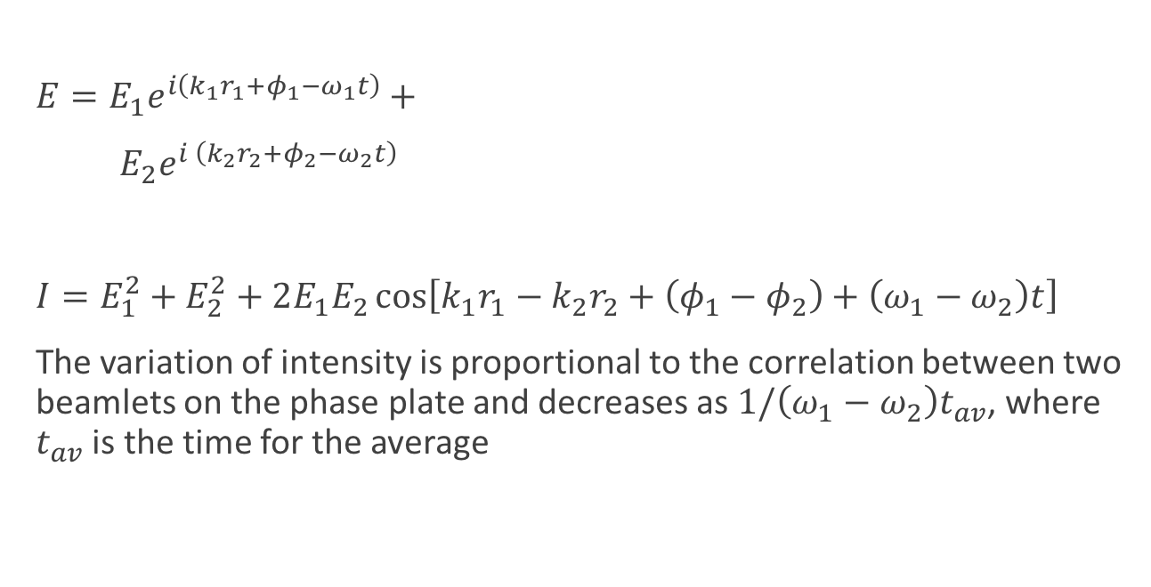
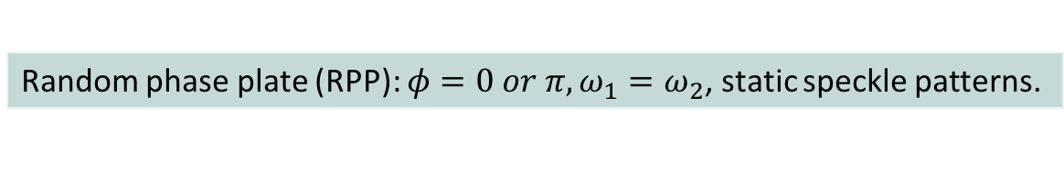
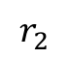
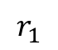
Phase plates introduce random phase shift and break one laser beam into many beamlets
Laser
$E=E_{1}e^{i\left(k_{1}r_{1}+φ_{1}−ω_{1}t\right)}+$
$E_{2}e^{i \left(k_{2}r_{2}+φ_{2}−ω_{2}t\right)}$
$I=E_{1}^{2}+E_{2}^{2}+2E_{1}E_{2}\cos\left[k_{1}r_{1}−k_{2}r_{2}+\left(φ_{1}−φ_{2}\right)+\left(ω_{1}−ω_{2}\right)t\right]$
The variation of intensity is proportional to the correlation between two beamlets on the phase plate and decreases as $1/\left(ω_{1}−ω_{2}\right)t_{av}$, where $t_{av}$ is the time for the average
$$E_{1}$$
$$r_{1}$$
$$E_{2}$$
$$r_{2}$$
Phase plate
Focal plane
Random phase plate (RPP): $φ=0 or π, ω_{1}=ω_{2}$, static speckle patterns.

Slide 10
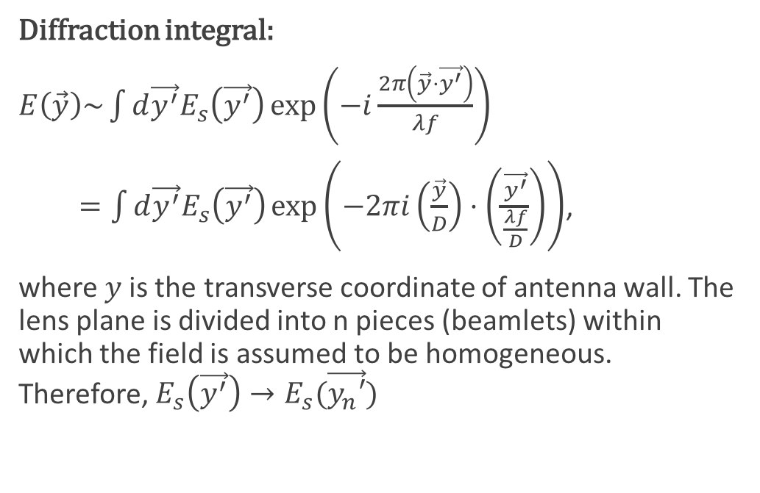
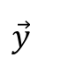
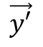
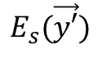
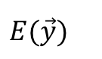
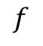
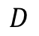
Fields at lens plane and focal plane are Fourier transform pairs
Diffraction integral:
$E\left(\vec{y}\right)\sim \int{d\vec{y^{′}}E_{s}\left(\vec{y^{′}}\right)\exp\left(−i\frac{2π\left(\vec{y}⋅\vec{y^{′}}\right)}{λf}\right)}$
$=\int{d\vec{y^{′}}E_{s}\left(\vec{y^{′}}\right)\exp\left(−2πi\left(\frac{\vec{y}}{D}\right)⋅\left(\frac{\vec{y^{′}}}{\frac{λf}{D}}\right)\right)}$,
where $y$ is the transverse coordinate of antenna wall. The lens plane is divided into n pieces (beamlets) within which the field is assumed to be homogeneous. Therefore, $E_{s}\left(\vec{y^{′}}\right)→E_{s}(\vec{y_{n}′})$
$$\vec{y′}$$
$$\vec{y}$$
$$E_{s}(\vec{y′})$$
$$D$$
$$E(\vec{y})$$
$$f$$

Slide 11
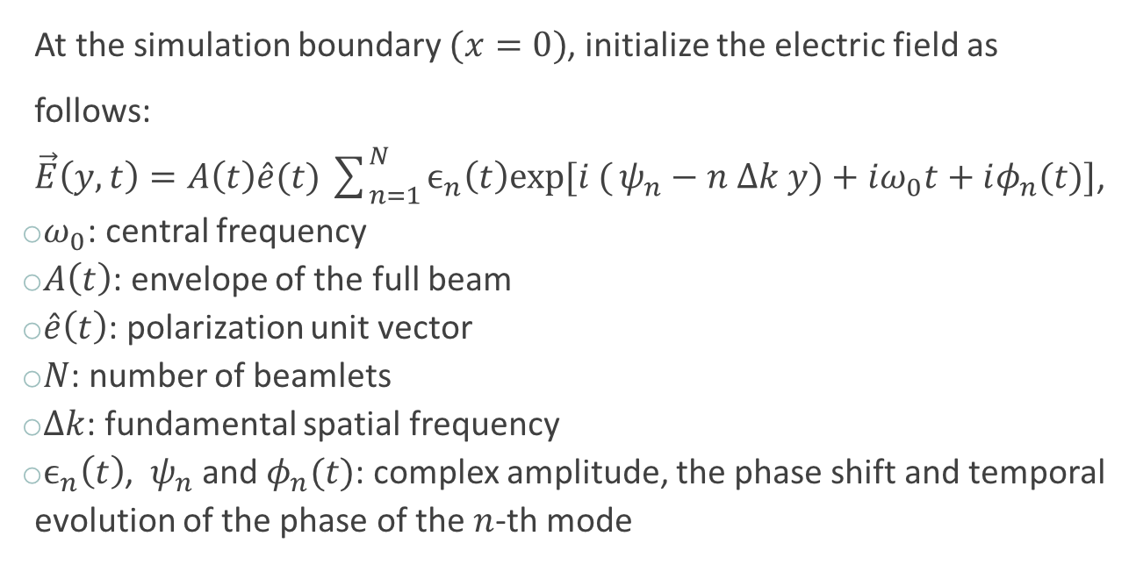
A general form of speckle antenna for particle-in-cell codes
At the simulation boundary $(x=0)$, initialize the electric field as follows:
$\vec{E}\left(y, t\right)=A\left(t\right)\hat{e}(t)\sum_{n=1}^{N}{ϵ_{n}\left(t\right)exp[i (}ψ_{n}−n Δk y)+iω_{0}t+iφ_{n}(t)]$,
$ω_{0}$: central frequency
$A\left(t\right)$: envelope of the full beam
$\hat{e}\left(t\right)$: polarization unit vector
$N$: number of beamlets
$Δk$: fundamental spatial frequency
$ϵ_{n}\left(t\right)$, $ψ_{n}$ and $φ_{n}(t)$: complex amplitude, the phase shift and temporal evolution of the phase of the $n$-th mode

Slide 12
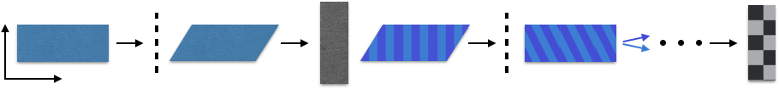
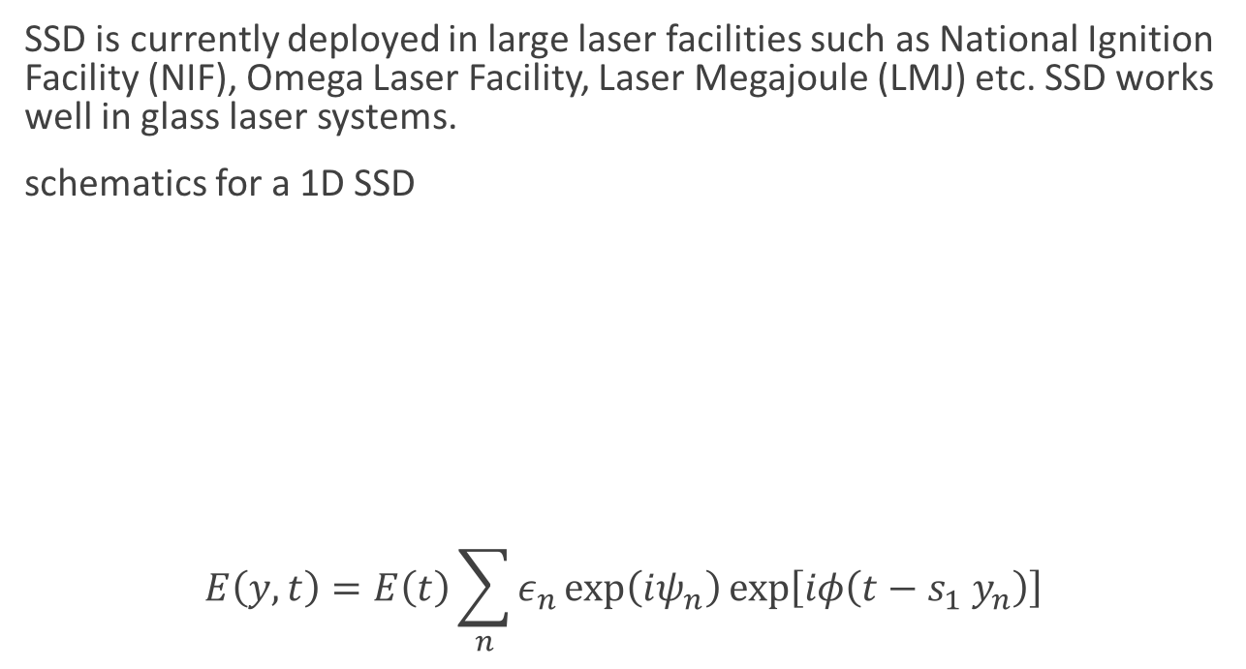
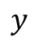
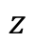
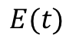
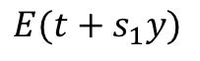
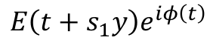
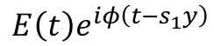
Smoothing by spectral dispersion* (SSD)
SSD is currently deployed in large laser facilities such as National Ignition Facility (NIF), Omega Laser Facility, Laser Megajoule (LMJ) etc. SSD works well in glass laser systems.
schematics for a 1D SSD
$$E\left(y, t\right)=E\left(t\right)\sum_{n}{ε_{n}\exp\left(iψ_{n}\right)\exp\left[iφ\left(t−s_{1} y_{n}\right)\right]}$$
laser pulse
phase modulator
phase plate
grating 1
grating 2
$$y$$
$$z$$
$$E(t)$$
$$E(t+s_{1}y)$$
$$E\left(t+s_{1}y\right)e^{iφ\left(t\right)}$$
$$E\left(t\right)e^{iφ\left(t−s_{1}y\right)}$$
* Skupsky, S., Short, R. W., Kessler, T., Craxton, R. S., Letzring, S., & Soures, J. M. Journal of Applied Physics, 66(8), 3456. (1989)

Slide 13

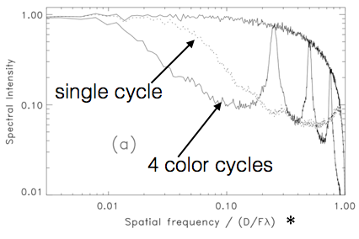
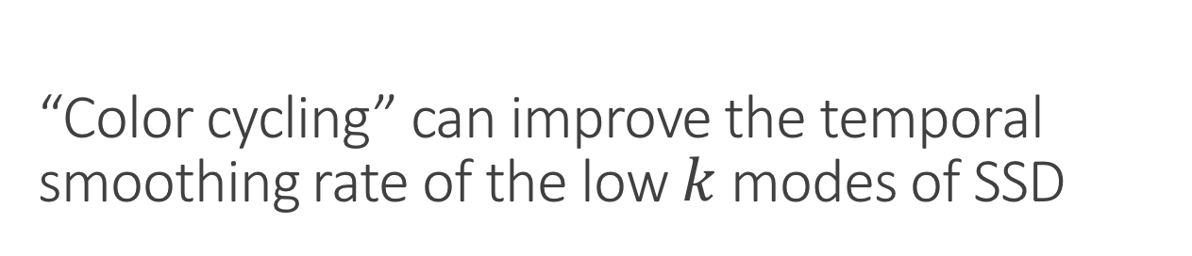
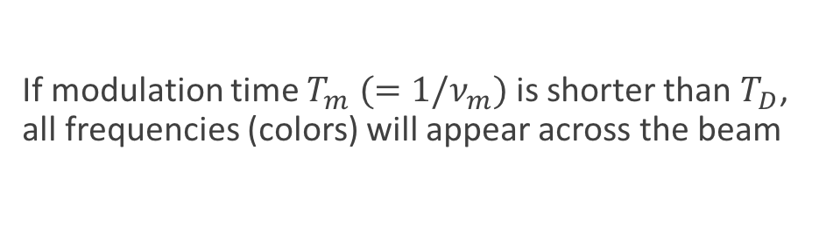
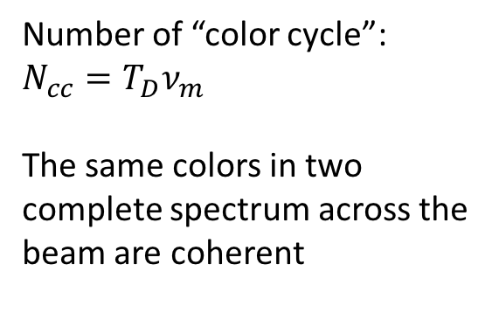
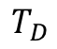
“Color cycling” can improve the temporal smoothing rate of the low $k$ modes of SSD
If modulation time $T_{m} (=1/ν_{m})$is shorter than $T_{D}$, all frequencies (colors) will appear across the beam
$$T_{D}$$
Number of “color cycle”: $N_{cc}=T_{D}ν_{m}$
The same colors in two complete spectrum across the beam are coherent
*
*Improved Beam Smoothing with SSD using Generalized Phase Modulation, J. E. Rothenberg , 1997

Slide 14
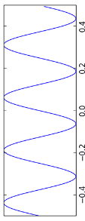
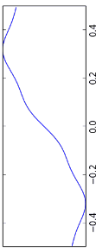
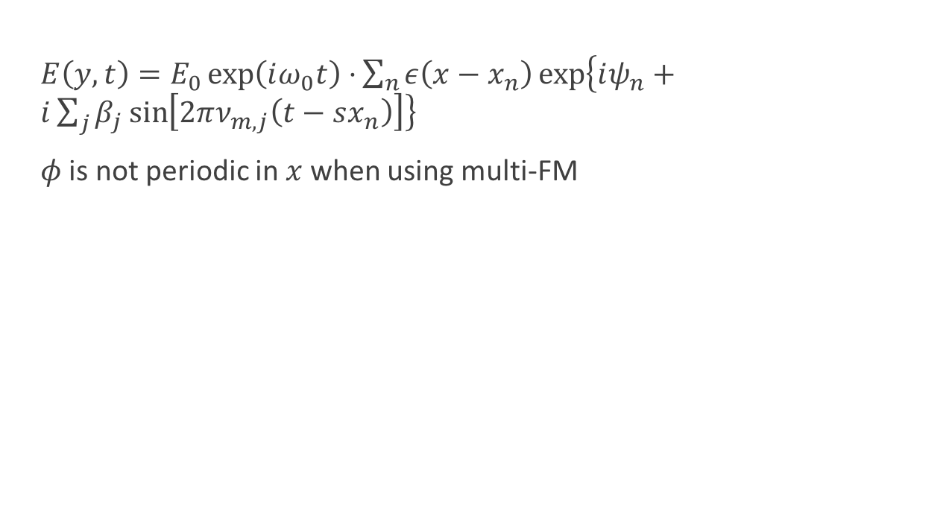
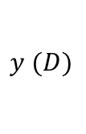
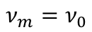
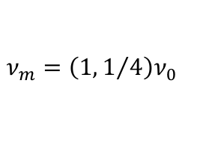
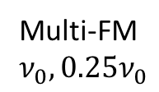
Multi-FM SSD can smooth every mode when using multiple color cycles
$E\left(y, t\right)=E_{0}\exp\left(iω_{0}t\right)⋅\sum_{n}{ε\left(x−x_{n}\right)\exp\left\{iψ_{n}+i\sum_{j}{β_{j}\sin\left[2πν_{m,j}\left(t−sx_{n}\right)\right]}\right\}}$
$φ$ is not periodic in $x$ when using multi-FM
$$ν_{m}=ν_{0}$$
$$ν_{m}={\left(1,1/4\right)ν}_{0}$$
4 color cycles
$$y (D)$$
Multi-FM
$$ν_{0}, 0.25ν_{0}$$
*
*Improved Beam Smoothing with SSD using Generalized Phase Modulation, J. E. Rothenberg , 1997

Slide 15
Input deck parameters related to SSD
The speckle antenna and the plane wave antenna share a lot of common parameters: a0, t_rise, t_flat, t_fall, omega0, pol, delay, direction, side
speckle{
…
n_speckle = 30, ! Number of speckles
laser_bandwidth = 0.001, ! Unit is laser frequency
phasemod_type = 2, ! Sinusoidal phase modulation
color_cycle = 8.8,
nfm = 4,
fm = 0.1, 0.3, 0.8, ! Normalize to the laser bandwidth
phasemod_amplitude = 3.1415, ! Pi by default
}

Slide 16
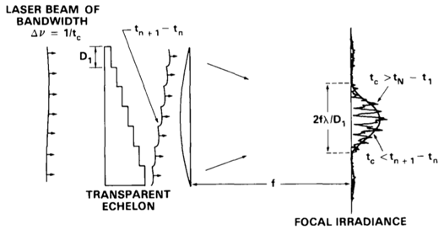
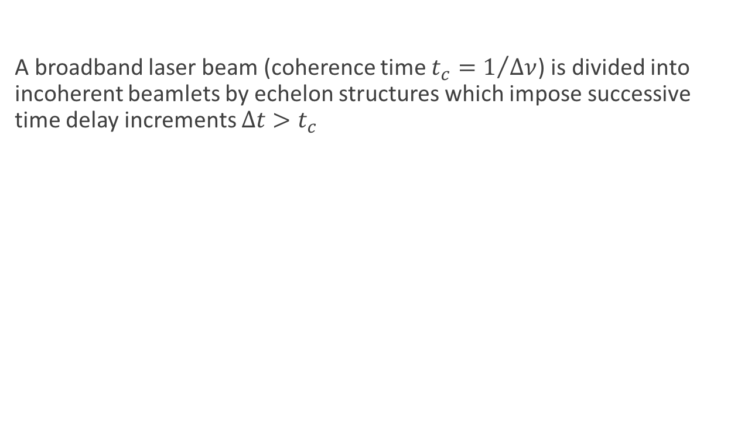
Induced spatial incoherence (ISI) scheme*
A broadband laser beam (coherence time $t_{c}=1/{Δν}$) is divided into incoherent beamlets by echelon structures which impose successive time delay increments $Δt>t_{c}$
*Lehmberg, R. H., Schmitt, A. J., & Bodner, S. E. Journal of Applied Physics, 62(7), 2680(1987)

Slide 17
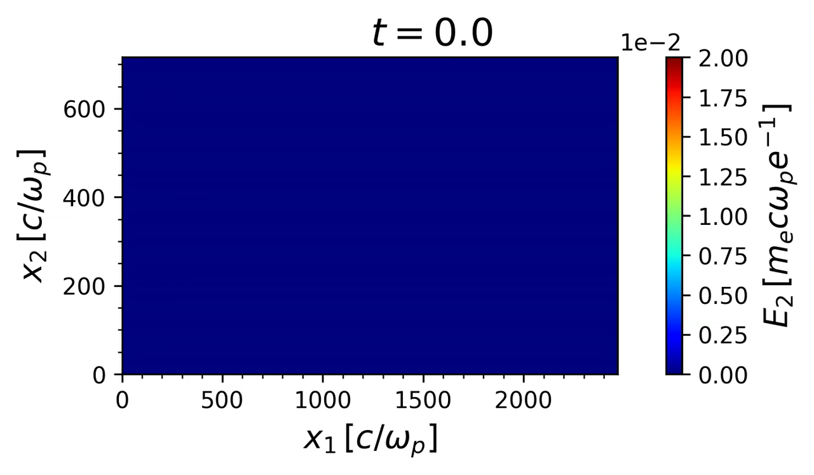
Launching ISI antenna
speckle{
…
! This override all !speckle specific !settings
amplitude_file = “filename”,
}
amplitude_file is a unformatted Fortran file:
integer :: number of grid points in time, nt
integer :: number of beamlets, nb
real(nb, nt) :: amplitude of the beamlets
real(nb, nt) :: phase of the beamlets

Slide 18
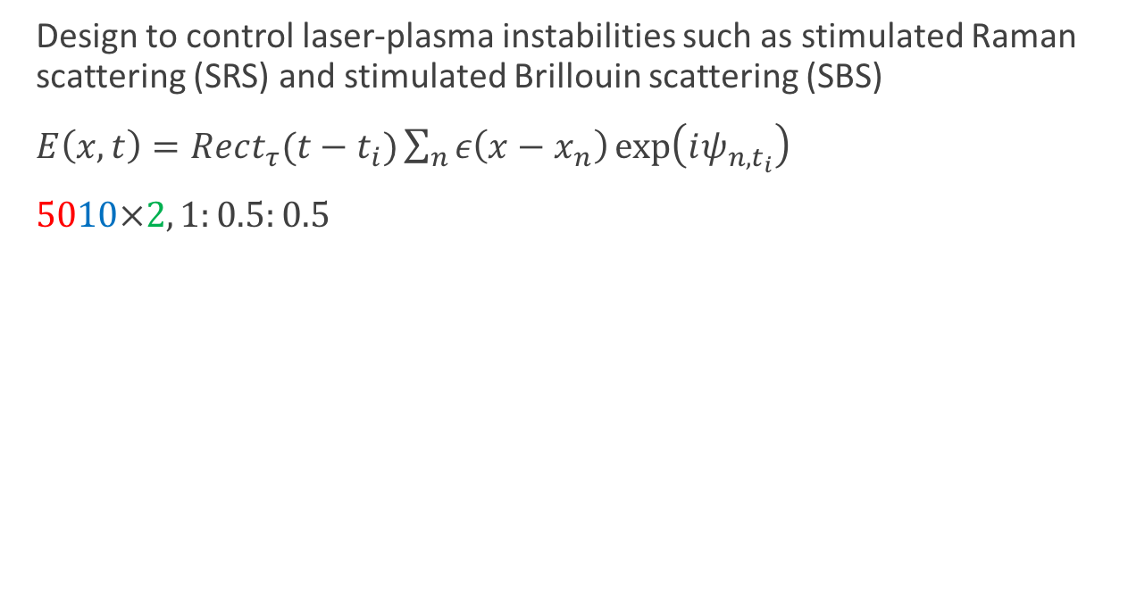
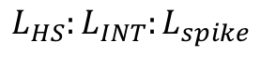
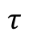
Spike train of uneven duration and delay* (STUD) pulse
Design to control laser-plasma instabilities such as stimulated Raman scattering (SRS) and stimulated Brillouin scattering (SBS)
$E\left(x, t\right)=Rect_{τ}(t−t_{i})\sum_{n}{ε\left(x−x_{n}\right)\exp\left(iψ_{n,t_{i}}\right)}$
$5010×2, 1:0.5:0.5$
$$τ$$
$$L_{HS}:L_{INT}:L_{spike}$$
Scramble the speckle patter every 2 spikes
$L_{HS}\sim 4f^{2}λ_{0}$ is the speckle length
$L_{INT}$ is the instability interaction length
$L_{spike}$ is the spike length
10% jittering
50% duty cycle
* Afeyan, B., & Hüller, S. Optimal control of laser plasma instabilities using Spike Trains of Uneven Duration and Delay (STUD pulses) for ICF and IFE. EPJ Web of Conferences, 59, 5009. (2013)

Slide 19
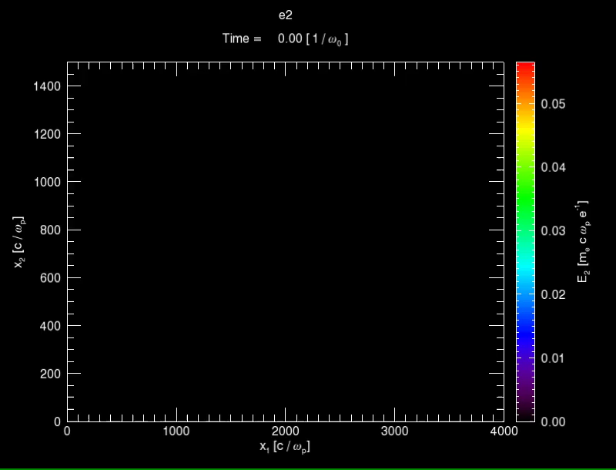
Sample input deck for STUD pulse
speckle {
…
n_speckle(1) = 30, speckle_type = 4, spike_period = 2000, spike_width = 1000, spike_jitter = 0, laser_bandwidth = 1.0, dt_update_speckle = 2000,
}

Slide 20
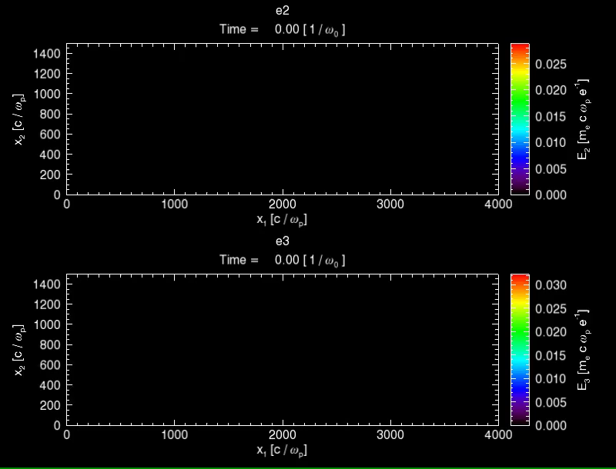
Alternating the polarization over time
speckle {
…
n_speckle(1) = 30,
dt_update_pol = 1000,
pol_stepping = 90.0,
}

Slide 21
This antenna is designed to control individual quantity independently
Most of the codes are located in os-speckle.f90
Interface:
read_nml: read the name list
restart_read: read restart files
restart_write: write restart files
new: allocate memory, initialize random phase
launch: calculate the field
speckle_on: check if the speckle is turn on
cleanup: deallocate memory

Slide 22

Main steps to compute the antenna field on the boundary (2D case)
$\vec{E}\left(y, t\right)=A\left(t\right)\hat{e}(t)\sum_{n=1}^{N}{ϵ_{n}\left(t\right)exp[i (}ψ_{n}−n Δk y)+iω_{0}t+iφ_{n}(t)]$
Read input deck and allocate memory beam_amp_2d(N), pp_2d(N) and phase_2d(N); amp_buff and phase_buffer (if read from file)
If speckle_on is true then call subroutine speckle_2d(this, efield, bc, dt, t, lower_bound, delta_x)
If mod(t, dt_update_speckle)<dt then update beam_amp_2d and phase_2d (beam_amp_2d and phase_2d are independent random time series if ISI, beam_amp_2d = 1 and phase_2d = pp_2d + βsin(νt) if FM SSD, is a random process if phase_2d if phasemod_type = 1)
If mod(t, dt_update_pol)<dt then update polarization (pol += pol_stepping)
Determine the envelope in time

Slide 23
This antenna module is still under active development
Oblique incidence; multiple speckled antenna
Generate random time series with spectral method (when the FFT interface is included in master branch)
Modeling ISI without the external input file
Modeling random phase modulation with arbitrary spectrum (right now only Laurentzian spectrum is supported)
The correlation between beamlets is small but still correlated, in which case we need to store the random phase time series for a time window longer than the time delay between the first and the last beamlet.
Be more specific about the location of the simulation box, in which case more experimental parameters are needed: focal lens aperture, focal length etc.

